Slide 1
High altitude physiology
Dr RESHMY K.R
PROFESSOR
DEPARTMENT OF PHYSIOLOGY
SKHMC

Slide 2
Changes in the body at high altitude
Hypoxia
Expansion of gases
Fall in atmospheric temperature
Light rays

Slide 3
High altitude
Upto 10,000 ft 3000m
-Safe zone of rapid ascend
At 18,000 ft 5,500m
-Upper limit of permanent human inhabitants
Above 20,000ft 6,000m
-Life is endangered without supplemental oxygen
From 40,000ft 12,000m
-Ozone layer starts

Slide 4
Alveolar partial pressure at different altitudes

Slide 5
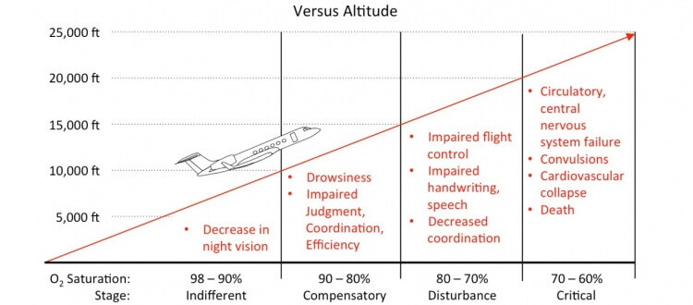

Slide 6
Hypoxia at high altitude depends on
Level of altitude
Rate at which hypoxia
Duration of exposure to hypoxia

Slide 7
When hemoglobin saturation falls below 65%
serious cellular dysfunction occurs;
and if prolonged, can cause death

Slide 8
Acute effects of Hypoxia
23,000ft
Coma, death
12,000 ft
Drowsiness, lassitude, headache, mental & muscle fatique
18,000ft
Seizures, twitching

Slide 9
Important acute effects of Hypoxia
Decreased judgement, mental proficiency, memory and performance of discrete motor movements
Unacclimatized Aviator stays at 15,000ft for 1hr , mental proficiency ordinarily fails to about 50% of normal & after 18hrs at this level it fails to about20% of normal

Slide 10
Effects of ascending to High altitude
Acute mountain sickness
High altitude pulmonary odema
High altitude cerebral odema
Chronic mountain sickness

Slide 11
Mountain sickness
adverse effect of hypoxia in high altitude

Slide 12
Acute mountain sickness
Symptom complex in individual residing at sea level ascends to high altitude for first time over a period of 1-2 days
Develop within 8-24 hrs after arrival at high altitude last for 4-8 days

Slide 13
Rapid ascent to above 10,00ft ----occurs in 3-4 days of rapid ascent , accompanied by physical exertion
Rapid ascent to above 10,00ft
Exposure to decreased partial pressure of oxygen to hypoxia
Cold exposure
Activation of Sympathetic N.S
Generalized vasoconstriction
Pulmonary circulation vasoconstriction
Increased pulmonary hydrostatic pressure
Altered Starlings forces transudation of fluid
Pulmonary odema

Slide 14
Pulmonary odema- ground glass appearance

Slide 15
High altitude cerebral odema
Acute cerebral odema
Decreased partial pressure of O2 at high altitude
Autoregulatory mechanism of cerebral circulation fails
Increase capillary pressure
Transudation of fluid into cerebral tissues

Slide 16
Ataxia, disorientation, coma, death

Slide 17
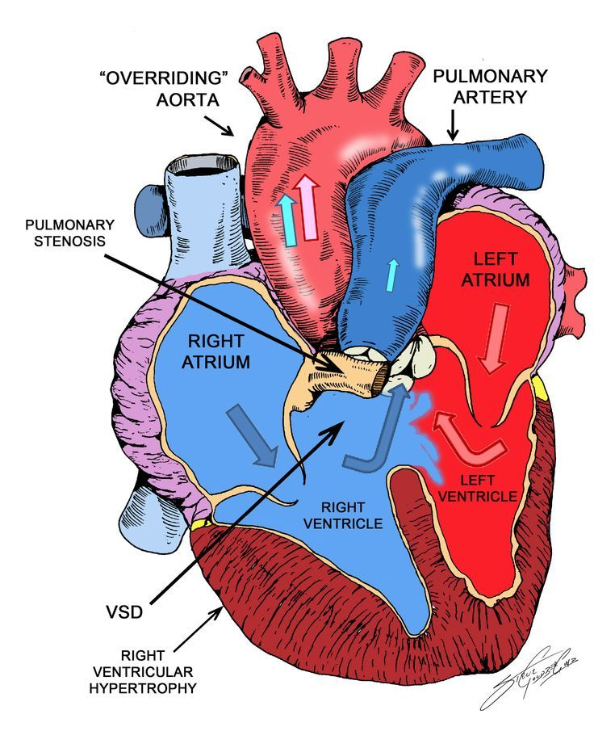
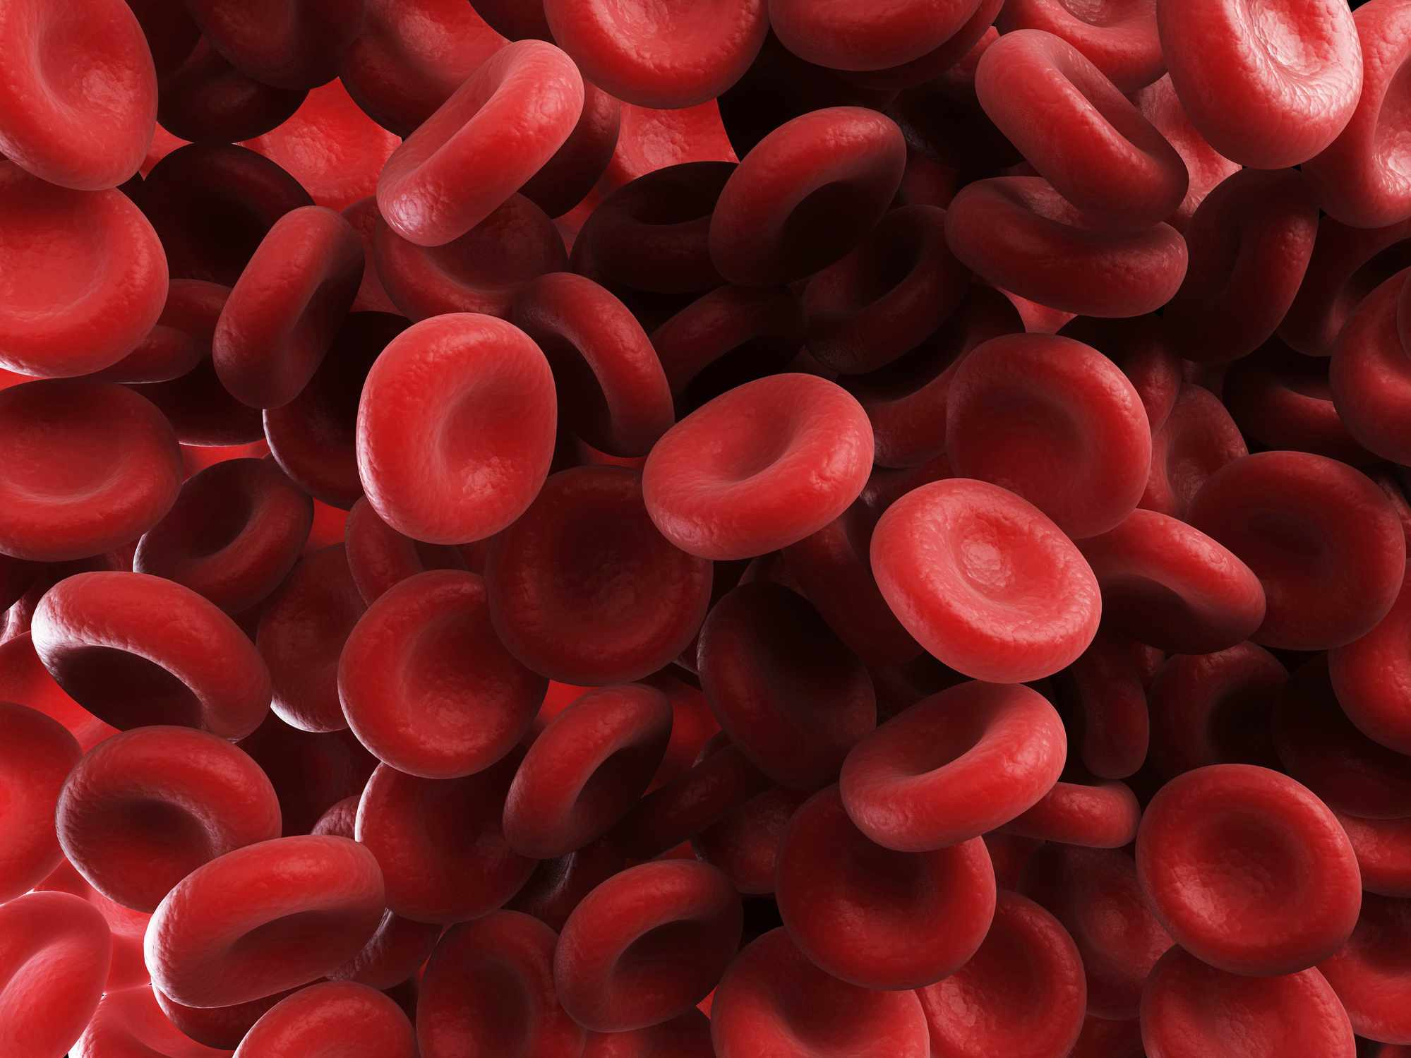
Chronic mountain sickness
Long term residents of High altitude

Slide 18
Natural Acclimatization
This occurs in people living from their birth at high altitude ,acclimatization begins them in infancy
Chest size increased
Increased CO
Increased ventilatory capacity
O2 Facilitate to tissues

Slide 19
Oxygen Hb dissociation curve for blood of high altitude residents & sea level residents
Arterial PO2 in the natives at high altitude is 40mm Hg(greater qnty of Hb), qnty of O2 in the arterial blood is greater than that in the blood of natives at the lower altitude

Slide 20
Physiological response to hypoxia to increase oxygen delivery at high altitude
Immediate reflex
Adjustment of respiratory and CVS Accommodation
Changes in body tissues to response to long term exposure to hypoxia
-Acclimatization

Slide 21
Accommodation by renal compensation
Hyperventilation due to stimulation of Chemoreceptors-CO2 is washed off –at the same time renal compensation occurs,urine becomes slightly alkaline
Respiratory Alkalosis corrected by kidney
HCO3 – excretion in urine
Decrease pH

Slide 22
CVS
Cardiac output increases
tachycardia

Slide 23
In Metabolism
Increase in 2,3 DPG –shift of OHDC to rt- maintain tissue o2 tension

Slide 24
Acclimatization- Blood response
Hb con increases -20g/dl
PCV -60%
Increase blood volume

Slide 25
Respiratory changes in acclimatization
Increase in pulmonary capillary volume
Increase surface area increase in lung vol
Increase in pulmonary lung volume
Increase in pulmonary arterial pressure
Diffusing capacity increases to 3 folds

Slide 27
changes in CVS in acclimatization
Increase in HR, Force of contraction, increased CO
Increased capillary density in rt ventricular muscle

Slide 28
Cellular and tissue acclimatization
Increased mitochondrial density within cell
Capillary density increased in skeletal muscle and cardiac muscle
Cellular oxidative enzymes
Improved work capacity 70% compared to unacclimatized persons 50%
Native residents 87%

Slide 29
Fitness curve after acclimatization

Slide 30
Differences
features | Acclimatized persons | Unacclimatized persons
Cellular changes | Increased mitochondria, oxidative enzymes | less
Respiratory system | Increased diffusing capacity , increased pulmonary ventilation | normal
CVS | HR, heart size, increased in force of contraction, increase CO Normal
Response to hypoxia | Hypocapnic Alkalosis Urine is alkaline | Acidic urine

Slide 31
Precautions
Limit time at altitude
Descend to a safe altitude

Slide 32
References
https://slideplayer.com/slide/13572231/
https://www.google.com/search?q=high+altitude+physiology+ppt&source=hp&ei=pNuDYbnUFpGUxc8P55anmAc&iflsig
THANK YOU

